Slide 1

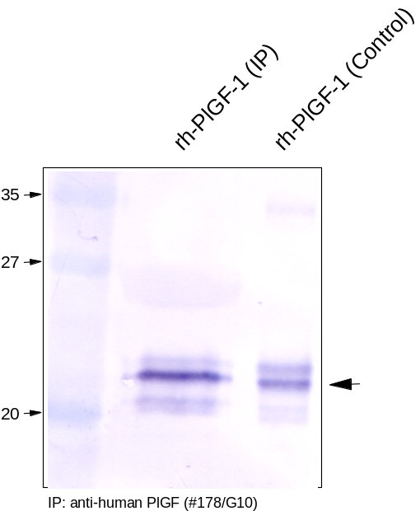
RELIATech GmbH
Immunoprecipitation with anti-human PlGF
(Cat #101-M67)
Fig. 1: Recombinant human PlGF-1 derived from insect cells was first precipitated using the monoclonal anti-human PlGF #178/G10. Western analysis was performed using a polyclonal antibody against human PlGF.
http://www.reliatech.de / info@reliatech.de

